Slide 1
Advance Java Topics
JDBC
Servlet
JSP
Spring - Java based framework
Hibernate- Java based ORM framework

Slide 2
Java EDITIONS
Core Java + JDBC => J2SE -> JAVA Standard Edition
Servlet + JSP => J2EE -> JAVA Enterprise Edition
Mobile app=> J2ME -> JAVA Micro Edition

Slide 3
JDBC version Support To JAVA
JAVA 1.6 JDBC Version 4.0
JAVA 1.7 JDBC version 4.1
JAVA 1.8 JDBC Version 4.2

Slide 4
DB
Username
Password
JAVA Class
Servlet
Submit
Login Successful
MVC Architecture
M – Model
V- View
C - Controller

Slide 5
1. Driver Software
Java
DB
2. Connection
Load the Drivers
Establish the Connection with DB using URL, username, password
Prepare the statements
Extract data from result sets
Close the connection.

Slide 6
JAVA JDBC
1. JDBC is technology which can be use to communicate with Database
2. JDBC part of JAVA STANDARD EDITION(J2SE)
3. JDBC is specification(Guidelines) provided by java vendor implemented by database
4. Database implementation provided is called Driver software
JAVA
JDBC
DB

Slide 7
JAVA JDBC
JDBC is Standard API which can communicate with any DB without rewriting our application ie DB independent API.
Most JDBC Drivers are developed in JAVA and work for any DB any OS, as it is platform independent technology.
Easily perform CRUD operation on DB using JAVA.
We can also perform complex operations(Joins and stored procedures)
Huge vendors support for JDBC.
https://www.oracle.com/java/technologies/industry-support.html

Slide 8
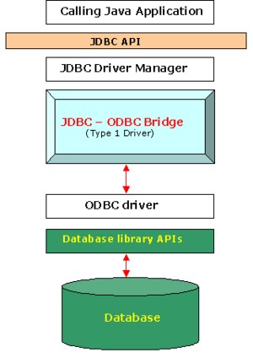
Type 1:JDBC-ODBC bridge driver
A type 1 JDBC driver consists of a Java part that translates the JDBC interface calls to ODBC calls. An ODBC bridge then calls the ODBC driver of the given database i.e. the driver converts JDBC method calls into ODBC function calls. The driver is platform-dependent as it makes use of ODBC which in turn depends on native libraries of the underlying operating system the JVM is running upon. Also, use of this driver leads to other installation dependencies; for example, ODBC must be installed on the computer having the driver and the database must support an ODBC driver. The use of this driver is discouraged if the alternative of a pure-Java driver is available.
Sun provides a JDBC-ODBC Bridge driver: sun.jdbc.odbc.JdbcOdbcDriver. This driver is native code and not Java, and is closed source.

Slide 9
Difference Between JDBC and ODBC
ODBC | JDBC
ODBC stands for open database connectivity | JDBC stands for JAVA database connectivity
Introduced by Microsoft in 1992 | Introduced by SUN Microsystems in 1997
We can use ODBC for language like c, c++, java | We can use JDBC only for JAVA language
Mostly ODBC drivers are developed by native language like c, c++ | Mostly JDBC drivers are developed in JAVA
For Java application it is not recommended to use ODBC because performance will be down due to internal conversion and application will become platform dependent | For Java it is highly recommended to use JDBC because there is no performance and platform independent problem

Slide 10
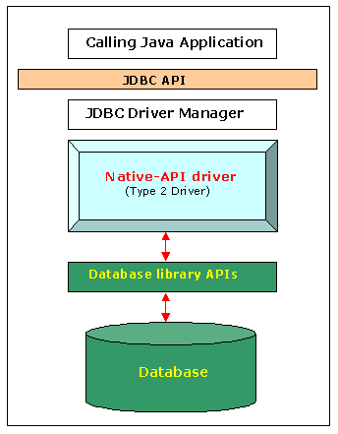
Type 2 : Native-API Driver
A type 2 JDBC driver is like a type 1 driver, except the ODBC part is replaced with a native code part instead. The native code part is targeted at a specific database product i.e. uses the client-side libraries of the database product. The driver converts JDBC method calls into native calls of the database native API.
This architecture eliminated the need for the ODBC driver and instead directly called the native client libraries shipped by the database vendors. This was quickly adopted by the DB vendors as it was quick and inexpensive to implement since they could reuse the existing C/ C++ based native libraries.

Slide 11
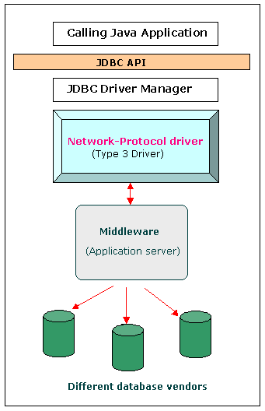
Type 3 : All Java + Middleware translation driver
A type 3 JDBC driver is an all Java driver that sends the JDBC interface calls to an intermediate server. The intermediate server then connects to the database on behalf of the JDBC driver. The middle-tier (application server) converts JDBC calls directly or indirectly into the vendor-specific database protocol.
Type 3 drivers sought to be a 100% Java solution but never really gained much traction. Type 3 drivers had a Java client component and a Java server component, where the latter actually talked to the database. Although this was technically a full Java solution, the database vendors did not like this approach as it was costly – they would have to rewrite their native client libraries which were all C/C++. In addition, this didn’t increase the architectural efficiency as we are really still a 3 tier architecture so it is easy to see why this was never a popular choice.

Slide 12
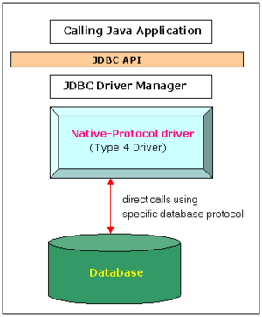
Type 4 : Pure Java driver
The JDBC type 4 driver, also known as the Direct to Database Pure Java Driver, is a database driver implementation that converts JDBC calls directly into a vendor-specific database protocol. It is implemented for a specific database product. Today, most JDBC drivers are type 4 drivers.
Written completely in Java, type 4 drivers are thus platform independent. They install inside the Java Virtual Machine of the client. This provides better performance than the type 1 and type 2 drivers as it does not have the overhead of conversion of calls into ODBC or database API calls. Unlike the type 3 drivers, it does not need associated software to work.
This architecture encapsulates the entirety of the JDBC API implementation along with all the logic for communicating directly with the database in a single driver. This allows for easy deployment and streamlines the development process by having a single tier and a small driver all in a 100% java package.

Slide 13
Statement interface
The Statement interface provides methods to execute queries with the database. The statement interface is a factory of ResultSet i.e. it provides factory method to get the object of ResultSet.
1. public ResultSet executeQuery(String sql): is used to execute SELECT query. It returns the object of ResultSet.
2. public int executeUpdate(String sql): is used to execute specified query, it may be create, drop, insert, update, delete etc.
3. public boolean execute(String sql): is used to execute queries that may return multiple results.
4. public int[] executeBatch(): is used to execute batch of commands.

Slide 14
Prepared Statement
Why use PreparedStatement?
Improves performance: The performance of the application will be faster if you use PreparedStatement interface because query is compiled only once.
public void setInt(int paramIndex, int value)
public void setString(int paramIndex, String value)
public void setFloat(int paramIndex, float value)
public int executeUpdate()- It is used for create, drop, insert, update, delete etc. public ResultSet executeQuery() -

Slide 15
Callable Statement
Why use CallableStatement?
CallableStatement interface is used to call the stored procedures and functions.
We can have business logic on the database by the use of stored procedures and functions that will make the performance better because these are precompiled.

Slide 16
DriverManager class
The DriverManager class acts as an interface between user and drivers. It keeps track of the drivers that are available and handles establishing a connection between a database and the appropriate driver. The DriverManager class maintains a list of Driver classes that have registered themselves by calling the method DriverManager.registerDriver().
Method | Description
1) public static void registerDriver(Driver driver): | is used to register the given driver with DriverManager.
2) public static void deregisterDriver(Driver driver): | is used to deregister the given driver (drop the driver from the list) with DriverManager.
3) public static Connection getConnection(String url): | is used to establish the connection with the specified url.
4) public static Connection getConnection(String url,String userName,String password): | is used to establish the connection with the specified url, username and password.

Slide 17
Connection Interface
A Connection is the session between java application and database. The Connection interface is a factory of Statement, PreparedStatement, and DatabaseMetaData i.e. object of Connection can be used to get the object of Statement and DatabaseMetaData. The Connection interface provide many methods for transaction management like commit(), rollback() etc.
1) public Statement createStatement(): creates a statement object that can be used to execute SQL queries.
2) public Statement createStatement(int resultSetType,int resultSetConcurrency): Creates a Statement object that will generate ResultSet objects with the given type and concurrency.
3) public void setAutoCommit(boolean status): is used to set the commit status.By default it is true.
4) public void commit(): saves the changes made since the previous commit/rollback permanent.
5) public void rollback(): Drops all changes made since the previous commit/rollback.
6) public void close(): closes the connection and Releases a JDBC resources immediately.

Slide 18
Transaction Management
Transaction represents a single unit of work.
Eg. Withdrawing Money, Transferring Money, Online Purchasing Mobile
Every transaction is single unit of work which compose of many instructions and must follow ACID property
Atomicity means either all successful or none.
Consistency ensures bringing the database from one consistent state to another consistent state.
Isolation ensures that transaction is isolated from other transaction.
Durability means once a transaction has been committed, it will remain so, even in the event of errors, power loss etc.
Methods-
1. void setAutoCommit(boolean status)
2. void commit()
3. void rollback()

Slide 19
Java Database Connectivity with 5 Steps
Register the Driver class
Create connection
Create statement
Execute queries
Close connection

Slide 20
1) Register the driver class
The forName() method of Class class is used to register the driver class. This method is used to dynamically load the driver class.
Syntax-
public static void forName(String className)throws ClassNotFoundException
Example
Class.forName("com.mysql.cj.jdbc.Driver");

Slide 21
2) Create the connection object
The getConnection() method of DriverManager class is used to establish connection with the database.
Syntax-
1) public static Connection getConnection(String url)throws SQLException
2) public static Connection getConnection(String url,String name,String password)
throws SQLException
Example
Connection con=DriverManager.getConnection(
"jdbc:mysql://localhost:3306/practice1","root","root");

Slide 22
3) Create the Statement object
The createStatement() method of Connection interface is used to create statement. The object of statement is responsible to execute queries with the database.Syntax-
public Statement createStatement()throws SQLException
Example
Statement stmt=con.createStatement();

Slide 23
4) Execute the query
The executeQuery() method of Statement interface is used to execute queries to the database. This method returns the object of ResultSet that can be used to get all the records of a table.
Syntax-
public ResultSet executeQuery(String sql)throws SQLException
Example
ResultSet rs=stmt.executeQuery("select * from emp");

Slide 24
5) Close the connection object
By closing connection object statement and ResultSet will be closed automatically. The close() method of Connection interface is used to close the connection.
Syntax-
public void close()throws SQLException
Example
con.close();

Slide 25
Class.forName("com.mysql.cj.jdbc.Driver");//Register the driver
String url="jdbc:mysql://localhost:3306/prac2";
String uname="root";
String pass="root";
String sql=“select * from emp”;
Connection con=DriverManager.getConnection(url,uname,pass);//creating connection
Statement stmt=con.createStatement(); //creating statement
ResultSet rs=stmt.executeQuery(sql); //executing query
while(rs.next())
{
System.out.println(rs.getInt(1)+" "+rs.getString(2));
}
con.close();//closing the connection
//executeUpdate for DML operations

Slide 26
PReparedStatemEnt
SQL Queries Syntax
//String sql="insert into product values(?,?)";//insertion
//String sql="update product set name=? where id=?";//updation
//String sql="delete from product where id=?";//deletion
//String sql="Select * from product where id=?";//reading

Slide 27
Examples
//insertion
//stmt.setInt(1,109);//1 specifies the first parameter in the query insertion
// stmt.setString(2,"Ratan");
//updation
//stmt.setString(1,"Sonoo");//1 specifies the first parameter in the query i.e. name
//stmt.setInt(2,101); //to specify the condition
//deletion
//stmt.setInt(1,101); //to specify the condition
stmt.executeUpdate();
//reading the data
ResultSet rs=stmt.executeQuery();

